Slide 1
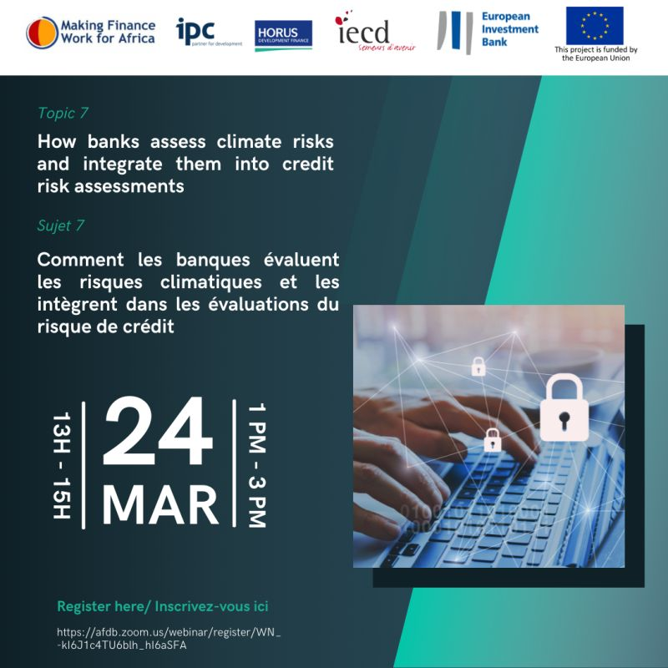
OUR webinar WILL START SHORTLY …

Slide 2





#MFW4A/EIBWEBINARSERIES
SUMMARY
Practical information
MFW4A
Panelists
PRESENTATIONS
Q&A

Slide 3







MFW4A/EIB WEBINAR SERIES
PraCtical Information
The duration of today's webinar is 75 minutes, including questions and answers
For better listening comfort, all participant microphones will be disabled for the duration of the webinar
Questions can also be submitted via "Q&A"
Simultaneous translation will be available in FR/EN/FR
Slides and a recording of this presentation will be circulated to registered participants within 72-hours following the webinar - They will also be available on MFW4A.ORG.
Send a message to the organizers if you encounter technical problems
Do not forget to complete the questionnaire which will automatically appear on your browser at the end of the session

Slide 4






MFW4A: Platform for harmonization and facilitation of financial sector development and knowledge sharing
Objectifs: Contribute to realizing the full potential of the African financial sector
Boosting economic development and reducing poverty in Africa
OUR DONORS
secretariat@mfw4a.org
www.mfw4a.org
ACKNOWLEDGMENTS TO THE EUROPEAN INVESTMENT BANK AND THE EUROPEAN UNION

Slide 5

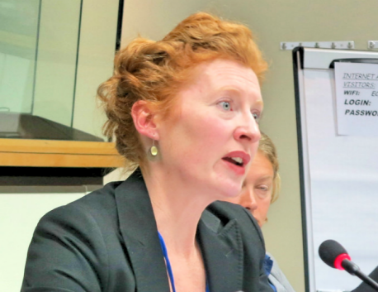
#MFW4A/EIB WEBINARSERIES
Moderator
Introduction
Carina Dunker
Director, green finance, IPC GmbH
Jane Feehan
EIB Regional representative, West Africa

Slide 6

EIB TECHNICAL ASSISTANCE PROGRAM FOR FINANCIAL SECTOR OPERATIONS IN WEST AND CENTRAL AFRICA
  Objective: Improve responsible financial inclusion by creating access to medium and long-term financial services for MSMEs, through loans and technical assistance to banks and microfinance institutions.

Slide 7
Theme 7: How banks assess climate risks and incorporate them into credit risk assessments

Slide 8








Addressing the climate challenge
1.5°C
Climate is changing => we need to adapt to the changes
Climate is changing => we mitigate further change and transit to carbon zero society
Climate resilient global society
Financial sector
Addresses the physical risks in its assets and operations
Addresses the transition risks in its assets and operations

Slide 9

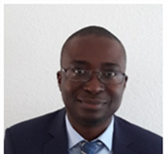
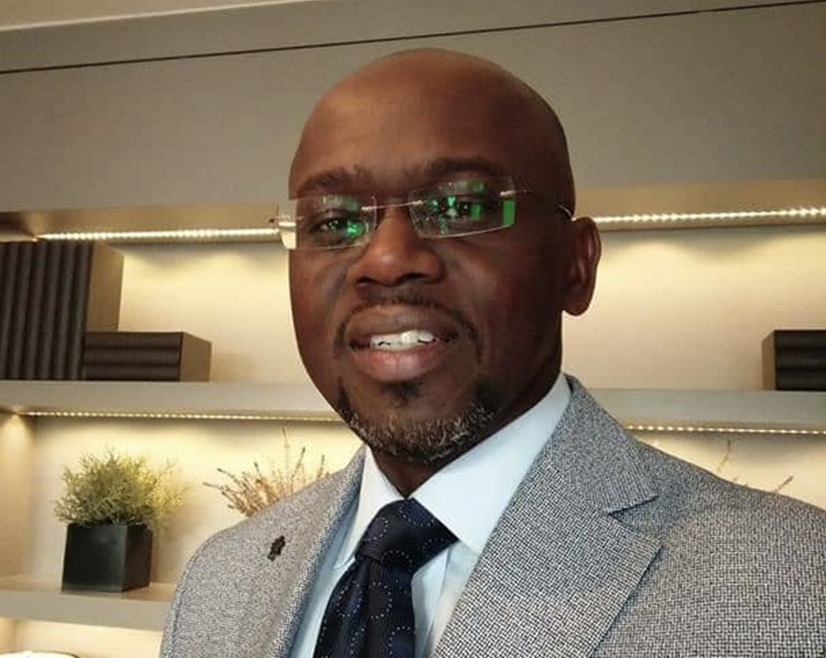
#MFW4A/EIBWEBINARSERIES
Panelists
Gerhard MULDER
Expert in climate finance, co-founder of CRS
Hermann Comoé
Agronomist, expert in physical climate risks, IPC
Marc Daubrey
Expert in climate finance, CEO of Green Invest Africa
9

Slide 10



This material is intended only for participants of Climate Risk Service’s ‘Climate Risk Training’ session.
Confidential & Proprietary. Copyright© 2022 by Climate Risk Services

Slide 11
Why does climate risk matter for financial institutions
By Gerhard Mulder –

Slide 12



Why is climate risk important?
Environmental and Social Materiality
Financial Materiality
Company’s impact on Climate
Climate’s impact on the Company
Primary audience:
Consumers/civil society/investors/employees
Primary audience:
Investors
page
01

Slide 13

Risk and opportunities
Opportunities for company and planet if product or service contributes to climate mitigation and adaptation
Risks for company through increasing climate hazards such as more extreme storms, heat stress, etc
Risks for company through increased regulation
page
02

Slide 14
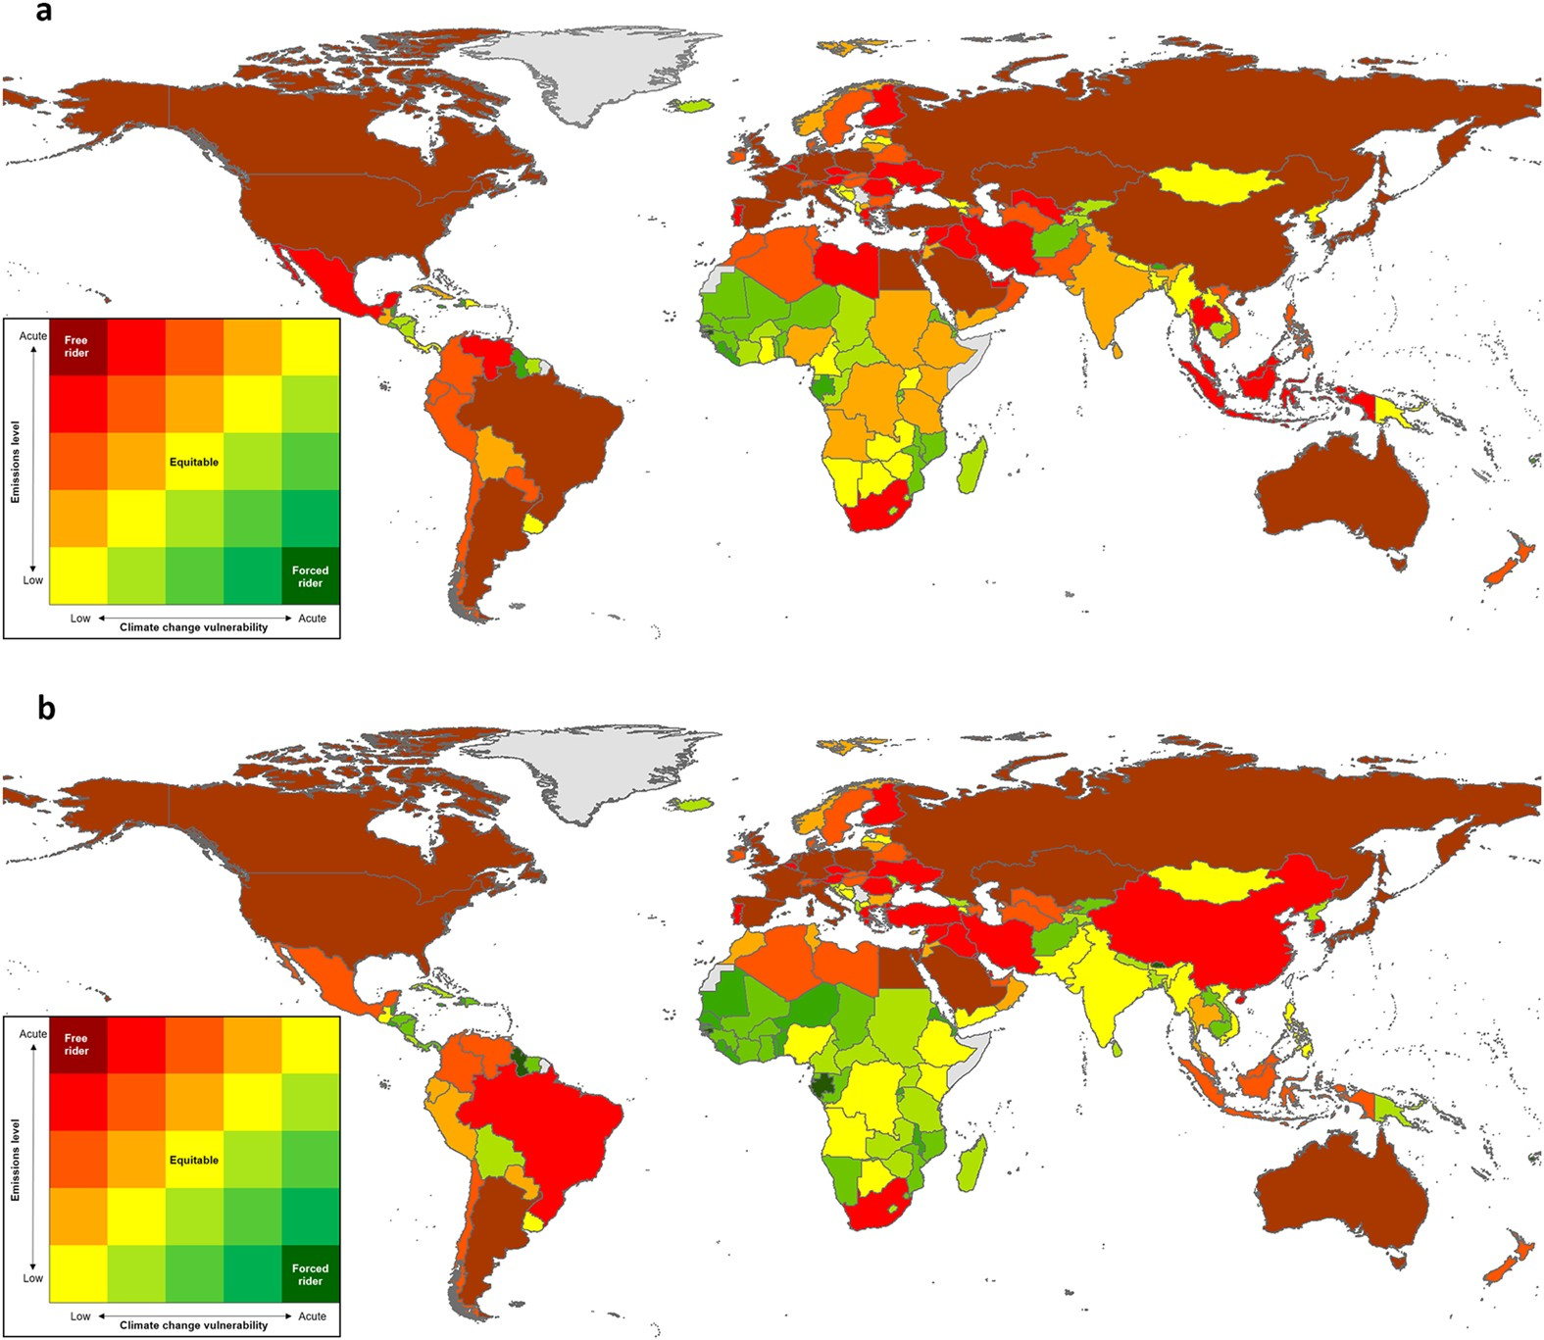
Risk and opportunities

Slide 15

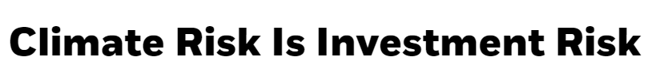

Climate Risk: BlackRock
“
“
Larry Fink’s Letter to CEOs
page
04

Slide 16

Climate Risk: Bank for International Settlements
The probabilistic and backward-looking risk management approaches that risk managers have relied on for decades is deemed incompatible with the uncertain and forward-looking nature of climate-related risks.
page
05
Notes:
Steph

Slide 17
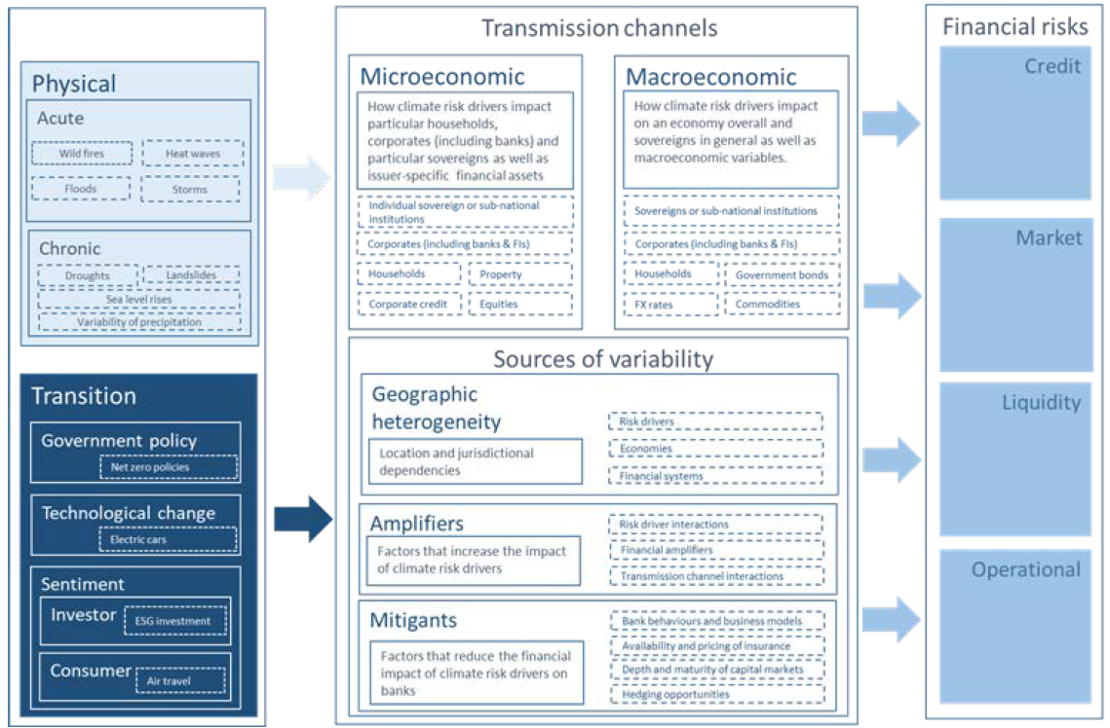
Transition Risk
Categories
page
06
Notes:
Gerhard
A little bit harder – who could give me an example of a category of transition risk?
Market & Tech: Changes in Supply/Demand for certain commodities, products, services. Technological innovations and obsolescence of existing technologies.
Energy: Volatility and uncertainty in energy mix and pricing.
Socio-Cultural: Increasing social awareness of climate risk leading to shifting societal values and behaviours.
Regulatory/Policy: Carbon-pricing mechanisms, stricter emissions limits, greater energy efficiency requirements, stricter water efficiency measures
Reputation: As social values shift and industry standards evolve, increasing exposure to changing perceptions of the sector or specific company from society, investors, consumers, etc.

Slide 18
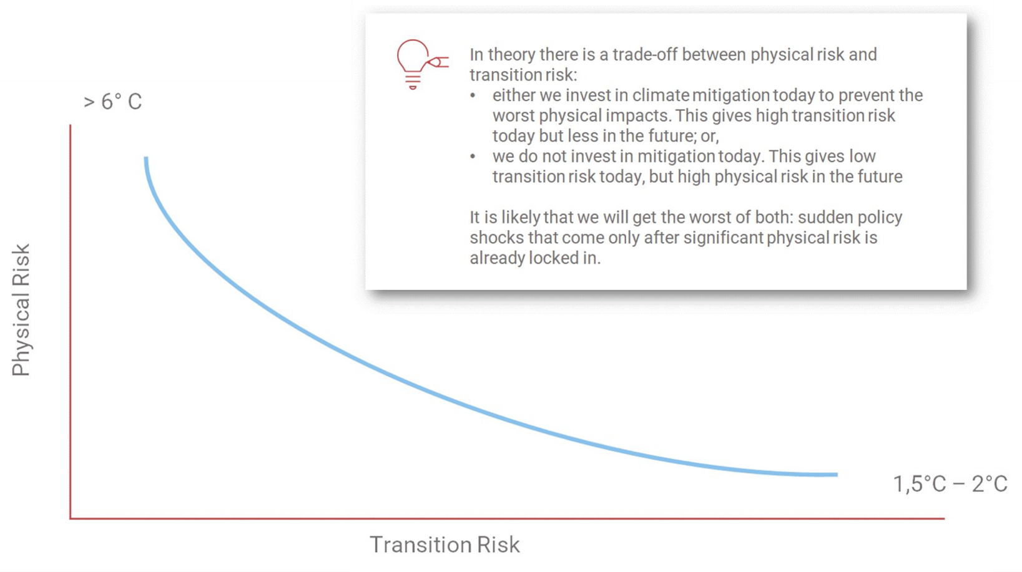
Physical Risk vs
Transition Risk
page
07
Notes:
Steph

Slide 19


Get Climate-Smart
www.climateriskservices.com
Confidential & Proprietary. Copyright© June 2020 by Climate Risk Services

Slide 20
The EIB West and Central Africa SME Banking and Microfinance Academy 2022
The Perspective of physical climate change and financial institutions
24 March 2022
By Hermann Comoé

Slide 21
Content
1. | Vulnerability to climate change in the agricultural sector | 03
2. | Physical climate risks assessment and consideration in the agricultural lending business | 04
3. | Adaptation and mitigation measures that could require Financial Institution services | 05
4. | Lesson learned | 07

Slide 22
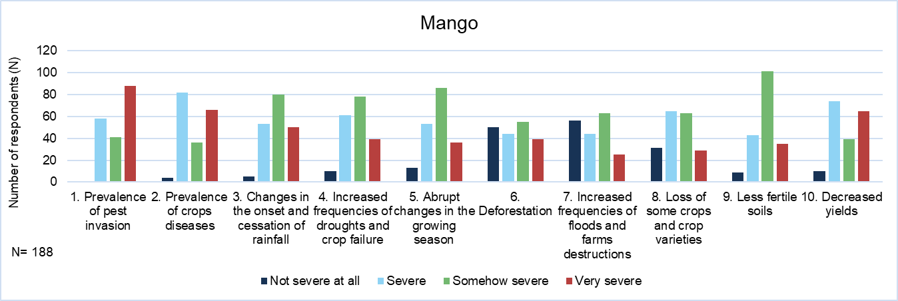
Vulnerability to climate change in the agricultural sector
In Africa, agricultural productivity growth has been reduced by 34% since 1961 due to CC
Future warming will negatively affect food systems in Africa by shortening growing seasons and increasing water stress
Global warming above 2°C will result in yield reductions for staple crops and tree crops across most of Africa compared to 2005 yields
Climate change poses a significant threat to African marine and freshwater fisheries
Mango sector in Ghana:
  Impact of pest, crop disease and reduction in water
  Decrease in yields and the quality of the fruits
Figure 1: Climate and environmental related hazards in the mango production sector in Ghana

Slide 23

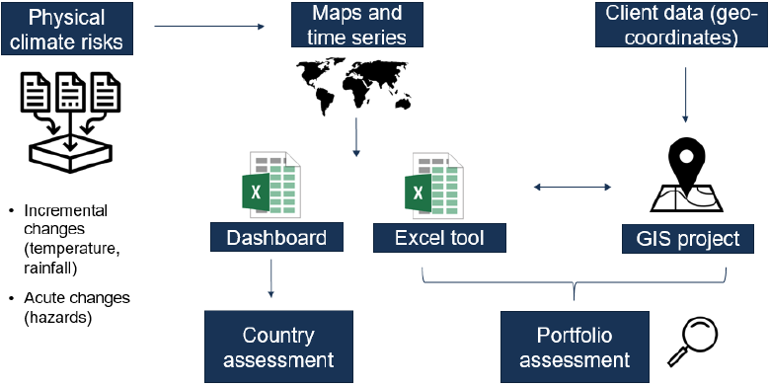
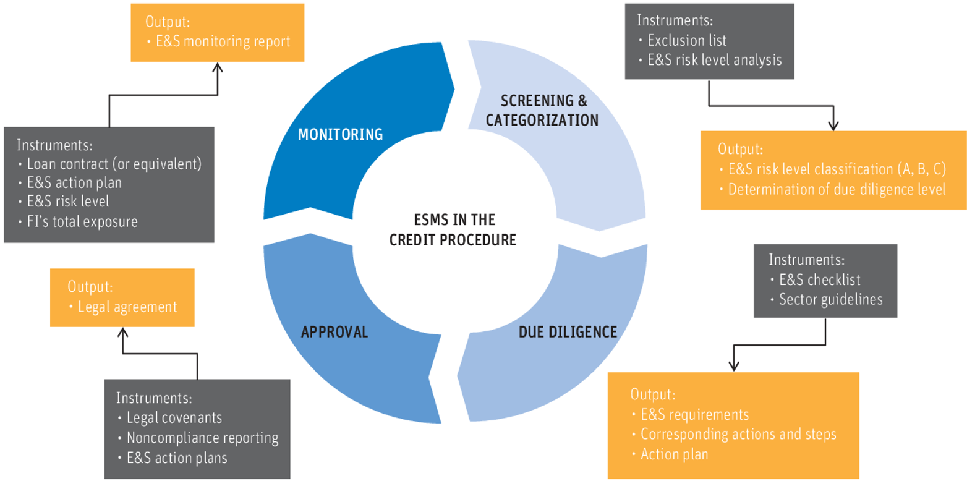
Physical climate risks assessment in the agricultural lending business
Dashboard and Portfolio analysis tool
Integration of “climate related standard” in the FI Environmental and Social Management System (ESMS)
Source: IPC
Notes:
Dashboard approach: For a general risk classification and straightforward comparison of all the bank countries, different climate-related indicators were first screened on country level only
The bank’s agricultural portfolio analysis: Due to its region-specific aspect, less aggregated data/information and time series will help better assessing the climate risks impact on the agricultural sector.

Slide 24
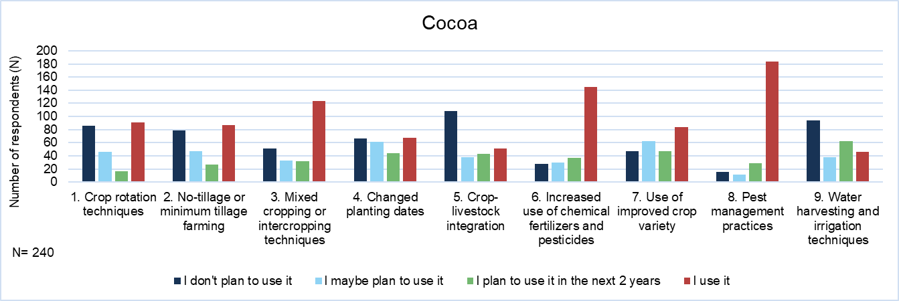
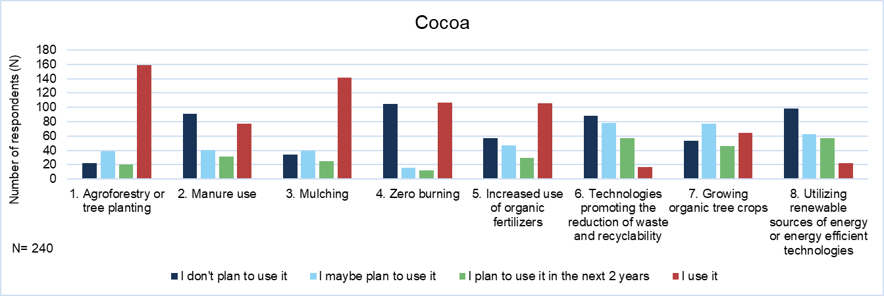
Adaptation and mitigation measures that could require FI services
Figure 3: Mitigation measures to reduce cocoa production carbon footprint (Ghana)
Figure 2: Adaptation measures to climate change in cocoa production sector (Ghana)
Source: IPC

Slide 25
Adaptation and mitigation measures that could require FI services
Agriculture
Technical irrigation that optimizes the water resource in zones of drought.
Use and training on improved seeds and varieties of crop resistant to water or thermal stress.
Energy
Use of biodigestors for production of electricity in rural areas.
Water and sanitation
Improvement and construction of mini-drainage systems for evacuation of storm water
Improvement in soil management and in the use of organic pesticides, which reduces soil erosion and pressure.
Installation of tree cover against risks of erosion of rivers and flooding
Use of renewable power sources (solar, wind, biomass, waste, hydraulic, etc.) in order to reduce vulnerability.
Installation of solar panels for power general linked to the use of technical irrigation.
Construction of mini-hydroelectric plants.
Use of practices for the reuse of water and training on the efficient management thereof
Application of devices and repairs to reduce leaks in drinking water and sewer systems
Installation of infrastructure and use of rainwater collection or storage techniques (reservoirs, ponds, natural wells)

Slide 26

Lesson learned
Relevance of climate and crop simulation models with high quality and quantity of input data
Potential Insurance Solution for the bank Agric. portfolio:
  Insurance Type: Parametric insurance based on gridded precipitation data
  Covered Risks: Drought, excess of rain
Insurance options
The bank buys insurance to protect their agric. portfolio against major weather risks (insurance at the meso-level, not at the single farm-level)
Farmer is obliged to have an insurance cover for obtaining credit from the bank
Figure 4: Example of climate zone classification
Notes:
Option 1:
Advantages: Low premium rates, minimized basis risk, low administrative costs (i.e. only one policy needs to be issued per bank).
Disadvantages: Bank buys insurance to protect their agricultural portfolio against major weather risks. Credit takers (i.e. farmers) will no be indemnified directly by the insurance.
Option 2:
Advantages: Low premium rates, farmer obtains insurance payout in case of a severe weather event which minimizes farmer’s default risk.
Disadvantages: High basis risk as parametric insurance product needs to represent production risks at the farm level, high administrative costs for insurance (i.e. thousands of policies need to be issued).

Slide 27
.
Tools to address and measure climate risks in the portfolio
By Marc DAUBREY
Climate Finance Specialist / CEO of Green Invest Africa

Slide 28
SPECIFIC APPROACH
Triptych Risk - Climate - Credit: Bank – SME
perspective
CHALLENGES AND REALITIES
The risk perception of green and greening SMEs by banks
POSSIBLE SOLUTIONS
Toolkit Box
01
02
03

Slide 29
1- SPECIFIC APPROACH
Triptych Risk - Climate – Credit : Bank – SME PERSPECTIVE
INDUSTRY SECTORS OF
GREEN SMEs - CLIMATE
ESG, TFCD
GREEN INVEST APPROACH
Sustainable forestry
Nexus Finance – Climate
Conception of innovative solutions for access to financing for SMEs
Sustainable agriculture
Bank
Energy (EnR, EE, Transport, Construction…)
Client relationships
Sustainable waste mgt.
Green and greening SMEs
Green Invest
Circular economy
Climate
Risk
Credit

Slide 30
Risk perception of green or greening SMEs by banks
2 – CHALLENGES AND REALITIES
Technical risks
Credit approval criteria
Risques spécifiques aux PME (vertes/verdissantes)
1
Credit risk
1
Admissibility
- Legally constituted SME
- Financial statements available
1
Lack of knowledge of climate sectors / green SMEs (difficult benchmarking)
2
Lack of risk assessment tools
2
Market risk
2
Financial aspects
- Repayment capacity
- IRR, NPV
- Financial debt ratio
3
Liquidity risk
3
Low creditworthiness
absence of guarantees
3
4
Operational risk
Competitive analysis
- Market growth rate
- SME client portfolio
4
Mismatch between needs and financing methods (short-term credit, overdrafts, etc.)
4

Slide 31
3- POSSIBLE SOLUTIONS
Toolkit Box
Guarantee / De-risking
Portfolio Guarantee,
Individual Guarantee,
Partial guarantee
Assistance
Technical assistance (capacity building, training, coaching, mentoring, …)
Monitoring
Blended finance
Grants, Green Equity, etc.
Green credit lines
Risk Assessment Approaches
Carbon footprint
Exposure to climate risks
5

Slide 32
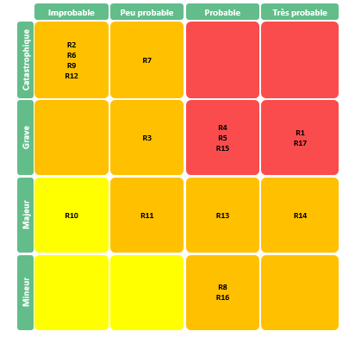
Climate risk assessment of green SMEs
Some Evaluation Indicators
Dashboard result
Industry sectors
Geographic location
Technologies used
Human resources
GHG emissions
Historical data
Climate modeling
Moderate
Critical
Very critical

Slide 33
THANK YOU FOR ATTENTION

Slide 34

#MFW4A/EIBWEBINARSERIES
Q&A
Submit your questions via the "Chat" or "Q&A"

Slide 35
Conclusion: key messages

Slide 36




#MFW4A/EIBWEBINARSERIES
www.msmefinanceta.eu
Contacts
Technical Assistance Programme
eibtawestafrica@ipcgmbh.com
MFW4A
secretariat@mfw4a.org
+225.20.26.39.53
CCIA, Rue Jean Paul II
Abidjan, Côte d’Ivoire
www.mfw4a.org

